Slide 1

Data-Driven Careers: A Closer Look at USA Job Postings for Analysts
Abhishek Kumar, Data Analyst.

Slide 2


Intro
In the ever-evolving landscape of the American job market, understanding the nuances of job postings is crucial for both job seekers and employers. As part of my data analysis initiative, I delved into a comprehensive dataset focusing on descriptive analysis on USA data analyst job postings, aiming to extract valuable insights and patterns within this dynamic ecosystem. The dataset encompasses key facets of job listings, ranging from fundamental details like job title, salary, and company name to geographical specifics such as the city and state. Additionally, I explore organizational attributes, including company size, year of establishment, and type of ownership. To provide a broader context, I’ve incorporated industry-related information, sector classification, and revenue statistics .

Slide 3
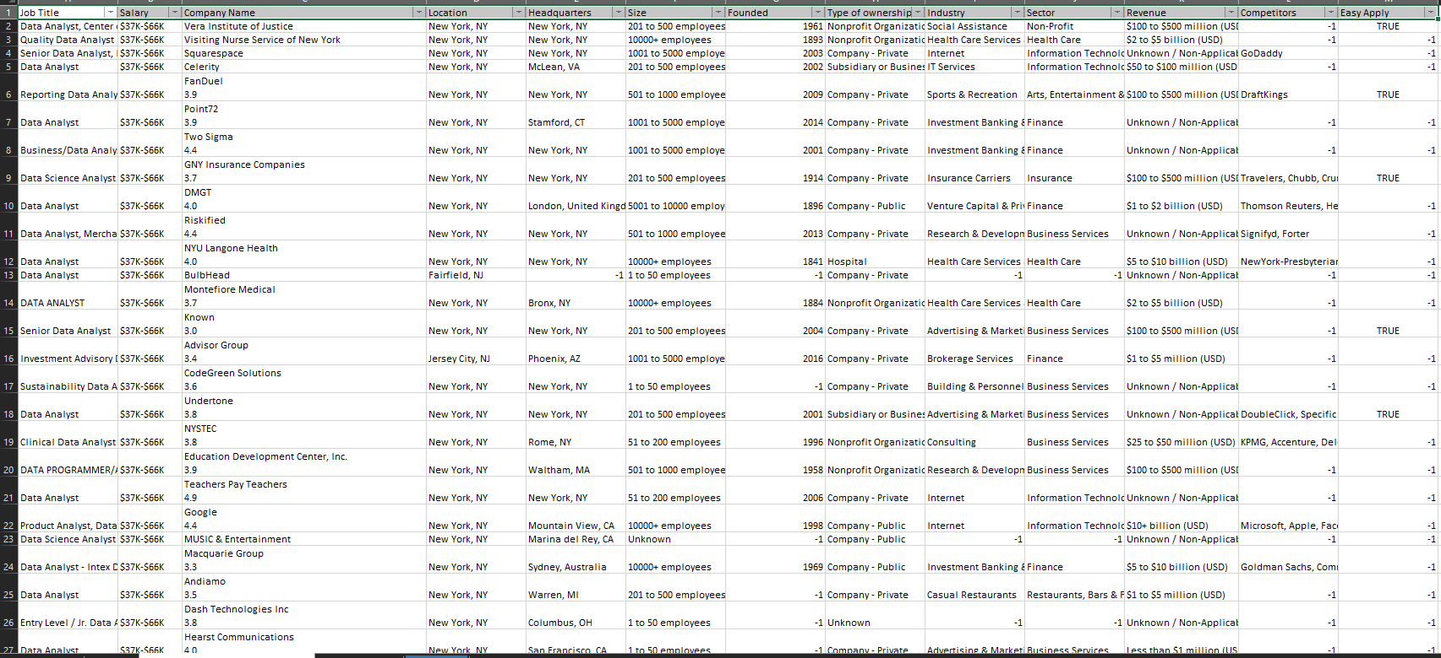
Data Preparation
Raw Data

Slide 4
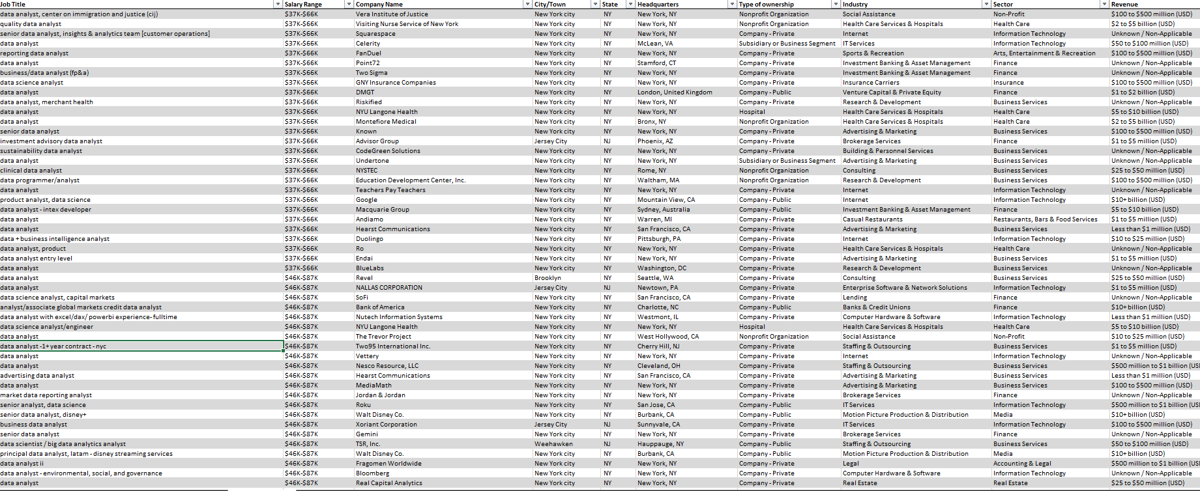
Cleaned Data
Platform : Power query.

Slide 5
Objectives / Posing questions :
What is top 3 or most common salary range company offering for data roles in USA ?
Scenario between new & old companies ? Which one is hiring more or have more job postings ?
What are the top 3 sectors / industries leaning towards data teams ?
Companies having market competitors are leaning towards more data teams hiring ?
Which states or cities have the highest numbers of analyst job posting ?
Top 3 roles / job tittle across data roles that company/industry prefers ?
Small or big companies hiring more ? Any correlation with competitors ?

Slide 6

($42K-$76K) , ($41K-$78K) , ($50K-$86K) are top 3 salary range offered to analysts in USA.

Slide 7
62%
In USA 62% of job posting is coming from new companies & late 20th century companies.
New companies are leaning towards data roles as data driven decision is now the primary concern & companies founded after 1970 or late 20th century companies are just falling behind new companies as it indicates these companies are adapting to data driven decisions to stay competitive in business .

Slide 8
IT , Business services , Finance sectors awaits an exciting career for analysts in USA as these produces 67% of job postings combindely .
Top 5 industry not only define tech landscape but make up a whopping 54% of all data role opportunities in USA !

Slide 9
Competitors fuels sectors/industries in strategic race towards data driven race , weather its new companies or late 20th century companies the data game is on to pursue a competitive age .

Slide 10
60%
California , Texas , New York offering 60% of analyst job postings .
While California remains the hotspot for analysts for its peak amount of job postings .

Slide 11

Start-up seems to be a sweet spot for data analytics role in industry as it is more fresher friendly .
Smaller player making big waves in talent pool ! Ma be dive into the numbers & join the data revolution .

Slide 12
As a role “data analyst” is leading in its own community by whooping 60% of analyst job postings .
Small companies are more leaning towards data teams building

